Slide 1

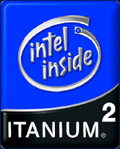



Computing Infrastructure Components
Components
Servers
Clients
LAN
Internet Connectivity
Software
Storage
Backup
Security
Computation
Integration is the Key !
Network
Data
Management

Slide 2
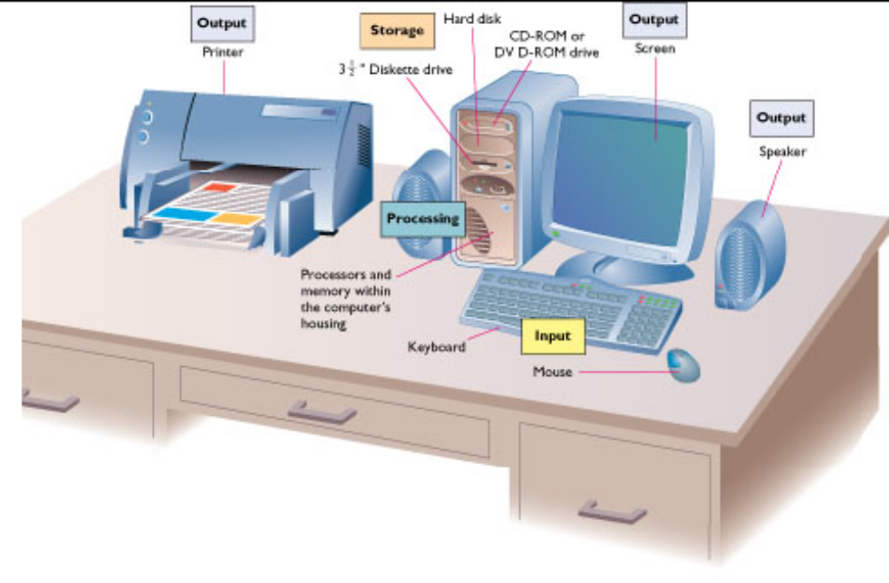
Today’s Computer
Computer

Slide 3
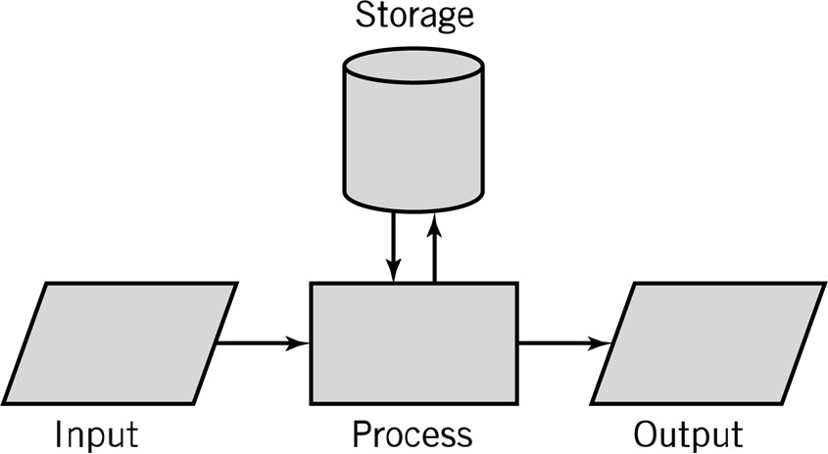
Computer Model
Computer
Input: keyboard, mouse, scanner, punch cards
Processing: CPU executes the computer program
Output: monitor, printer, fax machine
Storage: hard drive, optical media, diskettes,
magnetic tape

Slide 4
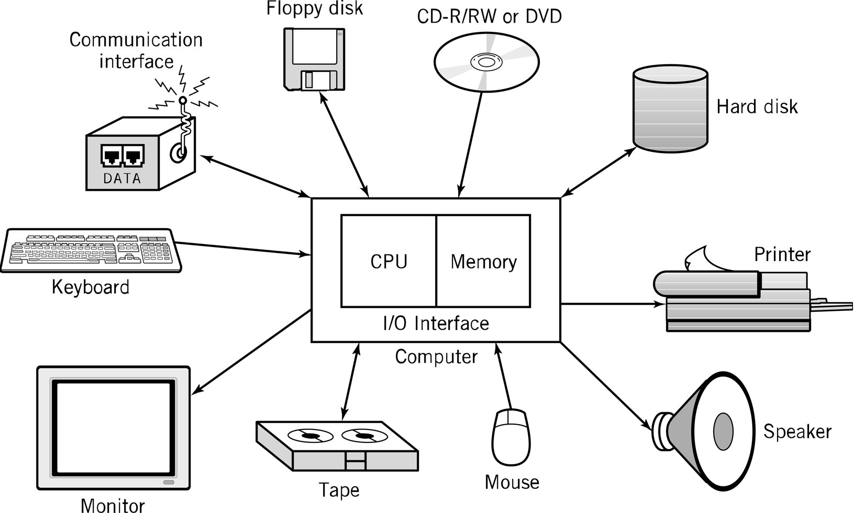
Computer Components
Components

Slide 5
Computer Components
Components
CPU
Mother Board
Memory
Hard Disk
Display
Keyboard
Mouse
Power Supply
Network Interface

Slide 6
CPU
CPU
CPU – Central Processing Unit (Microprocessor) consists of three parts:
  Control Unit
    Execute programs/instructions: the machine language
    Move data from one memory location to another
    Communicate between other parts of a PC
  Arithmetic Logic Unit
    Arithmetic operations: add, subtract, multiply, divide
    Logic operations: and, or, xor
    Floating point operations: real number manipulation
  Registers
CPU speed is influenced by several factors:
  Clock speed: Megahertz, Gigahertz
  Word size : 32-bit or 64-bit word sizes
  Cache: Level 1, Level 2 caches
  Instruction set size
Single Core/Multi Core

Slide 7
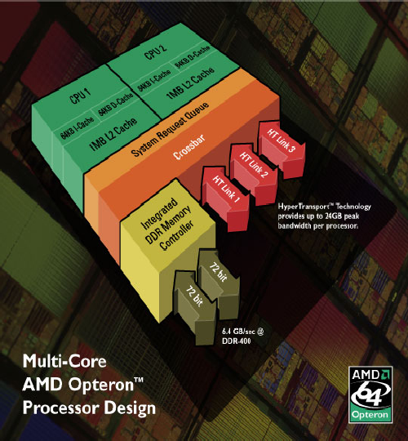
Multi-Core Processor Architecture
CPU

Slide 8
CPU
CPU
Desktop Processor: Intel (Pentium) Core 2 Duo/Quad, AMD Athelon (Dual/Quad Core)
Mobile Processor: Intel (Centrino 2) Core 2 Duo, AMD Turion (Dual Core)
Server Processor: Intel Xeon Quad Core, AMD Optron Quad Core, RISC (Reduced Instruction Set Computer): IBM Power PC, SUN SPARC ..
Atom Processor

Slide 9
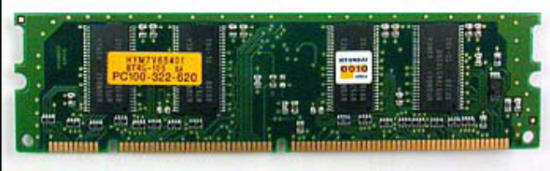
MEMORY
Memory
ROM: For BIOS (Basic Input Output System)
CMOS RAM: Battery-backed memory used to store system specific parameters required by the system BIOS to boot. It also stores the system clock information.
Cache: Static RAM attached to the CPU and used for
storing current data. L1, L2, L3 Cache
RAM: Dynamic RAM and used for storing Data and
programs which disappear after task
completed or power turned off
  Size: ex. 512MB, 2 GB ..
  Speed: ex. 533MHz, 667 MHz ..
  Type: ex. DDR2/3 SDRAM (Double Data Rate Synchronous RAM)
  Packaging: DIMM, SIMM…

Slide 10
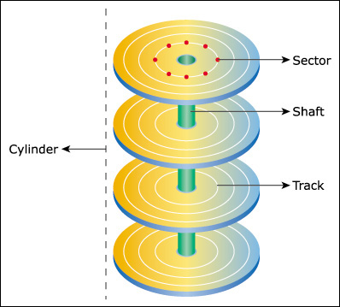
HARD DISK
Hard Disk
Magnetic storage device. It
stores data by magnetizing
particles on a disk.
Used to store operating
system, application
software, utilities and data.
Metal, plastic, or glass
platter(s)
2 magnetic surfaces/platter
1 or more platters per
spindle
3,600 – 15,000 rpm
1 head/platter
Head(s) move in and out

Slide 11
HOW DATA IS ORGANIZED ON DISK
Hard Disk
Tracks-
  Circular areas of the disk
  Length of a track one
  circumference of disk
  Over 1000 on a hard disk
  Data first written to outer
  most track
Sectors-
  Divides tracks sections
Cylinders-
  Logical groupings of the
  same track on each disk
  surface in a disk unit
Clusters-
  Groups of sectors used by
  operating system
  64 sectors in one cluster
Data stored in blocks
(pages) of .5 to 8 KB

Slide 12
HARD DISK
Hard Disk
IDE: Obsolete, also called PATA (Parallel Advanced
Technology Attachment ), I/O Rate: 16 MB/s originally
later 33, 66, 100 and 133 MB/s ,
SATA (Serial ATA): Used in Desktops/Laptops, I/O Rate:
1.5/3 Gbps, 5400/7200 RPM
SCSI (Small Computer System Interface ): Used in Servers,
10/15K RPM, I/O Rate: 160/320 MB/s
SAS (Serial Attached SCSI ): Used in Servers, 10/15K RPM,
I/O Rate: 3 Gbps
FC (Fiber Channel): I/O Rate 4 Gbps, Expensive and used in
Storage
iSCSI: I/O Rate 4 Gbps, Expensive and used in Storage
Solid State Drive: non-volatile flash memory

Slide 13
HARD DISK
Hard Disk
Low-level format- organizes both sides of each
platter into tracks and sectors to define where items
will be stored on the disk.
Partitioning: divide hard disk into separate areas
called partitions; each partition functions as if it were
a separate hard disk drive.
High-level format: defines the file allocation table
(FAT) for each partition, which is a table of
information used to locate files on the disk.

Slide 14
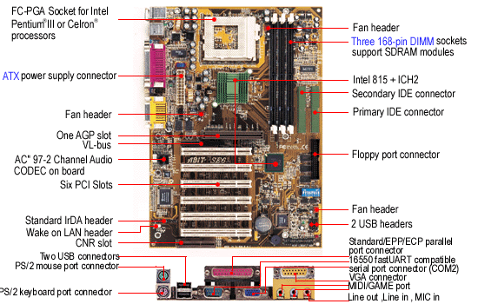
MOTHER BOARD
Mother Board
Holds CPU, memory, PCI bays, etc

Slide 15
CD/DVD Drive
CD/DVD
CD (Compact Disk)
  Capacity is 700 to 800 MB
  Optical storage device. Data is read from CD by a laser.
  Stores data as light and dark spots on the disk surface.
  They have an unlimited life-span.
  RO & RW CDs
  I/O Rate is Nx where 1x is 150KB/s, Read & Write speeds are not same, upto 52x speeds available
DVD (Digital Video Disk)
  4.7 GB
  RO & RW DVDs
  I/O Rate is Nx where 1x is 1.35MB/s, Read & Write speeds are not same, upto 20x speeds available
Blu Ray
  Upto 50 GB
  User Blue Laser

Slide 16
Adaptors (Expansion Cards)
Adapters
Use PCI Bus - Peripheral Components Interconnect (32 /64bit, Data Transfer Rate: 133 MB/s)
Mini PCI – used in laptops, 32 Bit, 33 MHz
PCI Express – Replacing PCI, 32/64 Bit, Data Transfer Rate: 8 GB/s
Adapters (Often Integrated on Motherboard)
  Video
  Sound
  Network Interface Card (NIC)
  Modem
  TV Tuner

Slide 17
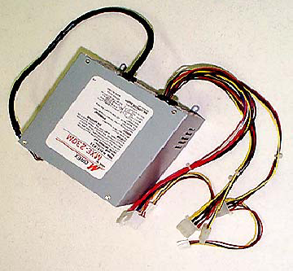
Power Supply
Power Supply
SMPS (Switched Mode Power Supply)
AC mains input is converted to DC voltage which feeds the Motherboard, drives and other devices.
ATX (Advanced Technology Extended)
Generally 90 - 250 watts

Slide 18
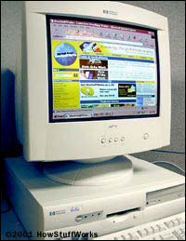
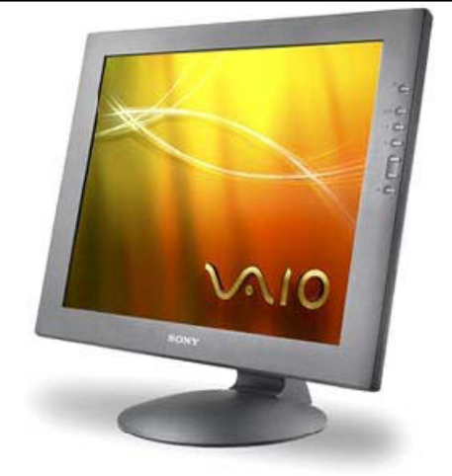
DISPAY
Display
CRT ( Cathode Ray Tube)
  Electron Gun & Florescent Screen
  Single Gun for Monochrome and 3 Guns for Colour Screen
LCD (Liquid Crystal Display)
  About blocking light when not needed
  TFT LCD (Thin Film Transistor LCD)
  19” in Desktop and 15” in Laptops
Power Consumption
  CRT – 110 watt
  LCD – 30-40 watt
Colour Depth: 65,000 colours, 24 million colours
Resolution: 1024x768, 1280x1024, 1600x1200

Slide 19
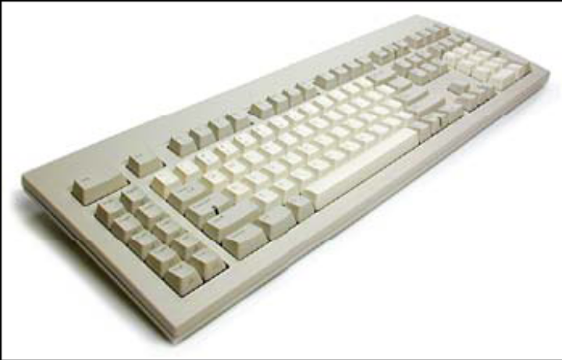
KEYBOARD
Keyboard
101-key Enhanced keyboard
104-key Windows keyboard, 3 more keys.
Press the Key - Detect the position on the key matrix (16 bytes)

Slide 20
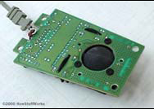
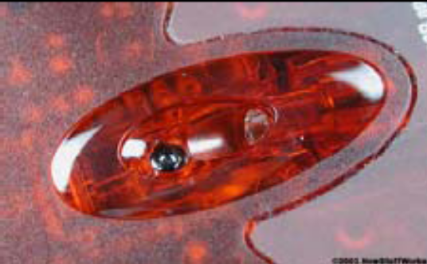
MOUSE
Mouse
Mechanical
  Use two rollers (one vertical and one horizontal) to track motion
  Rolled by the Track ball
Optical
  Use a tiny camera to tracking the motion
  LED (red light beamer)
IntelliMouse
  Extra wheel

Slide 21
Network Interface
NIC
10/100/1000 Integrated Network Interface
802.11 a/b/g/n Wireless Interface in Laptops

Slide 22
I/O Ports
I/O Ports
Parallel port
  Parallel because it can move a whole byte at a time
  Mainly used for connection to a printer
Serial port (Com port)
  One bit at a time -- Uses thin cable
Universal serial bus (USB) replaces those
  4 wires (2 for power & 2 for communication)
  Upto 60 MB/s
  USB Pen Drives, Printers, External Disks, Drives etc.

Slide 23
Printers
Printers
LaserJet (Mono & Colour)
Inkjet
Dot Matrix
Line

Slide 24
OS & Application Software
OS & Application Software
Application
Software
Operating
System
Driver
Driver
Hardware

Slide 25
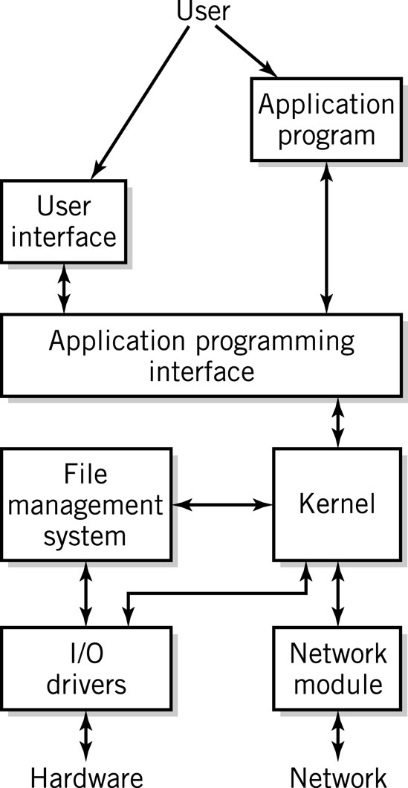
Software Component
Software Component
Applications
Operating System
  API: application program interface
  File management
  I/O
  Kernel
    Memory management
    Resource scheduling
    Program communication
    Security
  Network Module

Slide 26
What is an Operating System
Operating System
Operating System handles
  Memory Addressing & Management
  Interrupt & Exception Handling
  Process & Task Management
  File System
  Timing
  Process Scheduling & Synchronization
Examples of Operating Systems
  Single-user, Single-task: PalmOS
  Single-user, Multi-task: MS Windows and MacOS
  Multi-user, Multi-task: UNIX, Windows Server 2003/2008

Slide 27
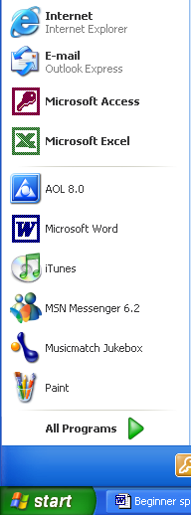
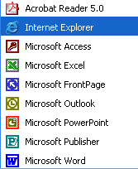
Application Software
Application Software
Application Software
performs a task for
the user
  Word – letters, memos
  Internet Explorer - Browser
  Outlook – Mail Client

Slide 28
OS & Application Software
OS & Software
Desktop
  OS: Windows (Vista/XP), Linux, Dual Boot
  Applications: MS Office, CAD Package, Compilers …
Application Servers
  OS: Windows (2000, 2003, 2008 Server), Linux, UNIX (HPUX, Solaris, AIX, IRIX etc.)
  Applications: NAG, Matlab, AutoCAD, Ideas, Oracle ..
Internet Servers
  OS: Windows, Linux
  Mail: Send mail/Postfix on Linux or Exchange on Windows
  DNS: Windows or Linux DNS Server
  Web: Apache on Linux or IIS on Windows
  Proxy: Squid on Linux or ISA on Windows
  Authentication: LDAP on Linux or Active Directories on Windows

Slide 29
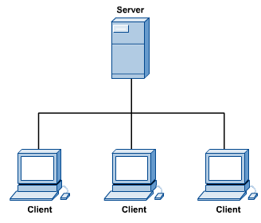
Computers: Clients and Servers
Clients and Servers
In a client/server network arrangement, network services are located in a dedicated computer whose only function is to respond to the requests of clients.
The server contains the file, print, application, security, and other services in a central computer that is continuously available to respond to client requests.

Slide 30
Servers
Servers
Desktop Server
Dual Processor (Dual/Quad Core) Server
Quad Processor (Dual/Quad Core) or higher SMP Server
Parallel Cluster using Dual/Quad Processor (Dual/Quad Core) servers clustered upto several Hundred Processors
Processor: Core 2 Duo/Athlon (Desktop), 64 Bit Intel Xeon (Quad Core), 64 Bit AMD Optron (Quad Core), Intel 64 Bit Itanium, RISC
OS: Linux, UNIX, Windows
RAM: 4 GB or Higher
Disk: Multiple 300 GB SAS

Slide 31
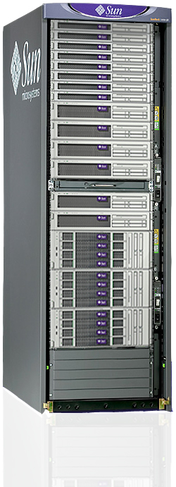
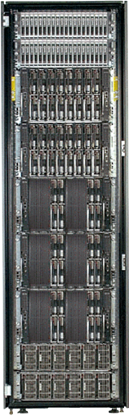
Servers (contd.)
Servers
Rack & Blade Servers

Slide 32
Workstations
Workstations
Application Specific Low-End Server
Dual/Quad Processor (Dual/Quad Core)
Processor: 64 Bit Intel Xeon, 64 Bit AMD Optron, Intel 64 Bit Itanium, RISC
OS: Linux, UNIX, Windows
RAM: 8 GB or Higher
Disk: Multiple 300 GB SAS

Slide 33
Clients
Clients
Desktop
Laptops
Hand Helds: PDA
Processor: Core 2 Duo, Athlon
OS: Windows, Linux, Dual Boot
RAM: 2 GB
Disk: 250 GB SATA

